Slide 1
Intro to Visualization:
or:
“How to avoid making bad charts and graphs”
Frank Elavsky, Data Visualization Specialist
Research Computing, Northwestern University
Notes:
Intro self
Rare breed of practitioner
But my insight can hopefully

Slide 2
Visualization is a Chainsaw
Use wisely.
Notes:
Franconeri and the dangers of the practice (hacking the brain)
Not empirical or scientific (although its effects can be studied this way)
It is a semantic discipline: making the symbolic geometric
Why? To generate insight that would be otherwise difficult.

Slide 3
Empathy and Awareness
Audience, Purpose, Context
Notes:
This means that visualization is about reducing difficulty
This is a form of communication that acknowledges a problem:
Humans are bad at understanding data
So we want our visualizations to decrease the effort it takes to understand something, this is the heart of the practice
(warn them about incoming theory)

Slide 4
Audience
Notes:
First:
Who is the visual for?
A research paper that will be read by peers?
An internal report?
A board meeting?
A sales pitch?
The cover of a magazine?
A website?
The general public?

Slide 5
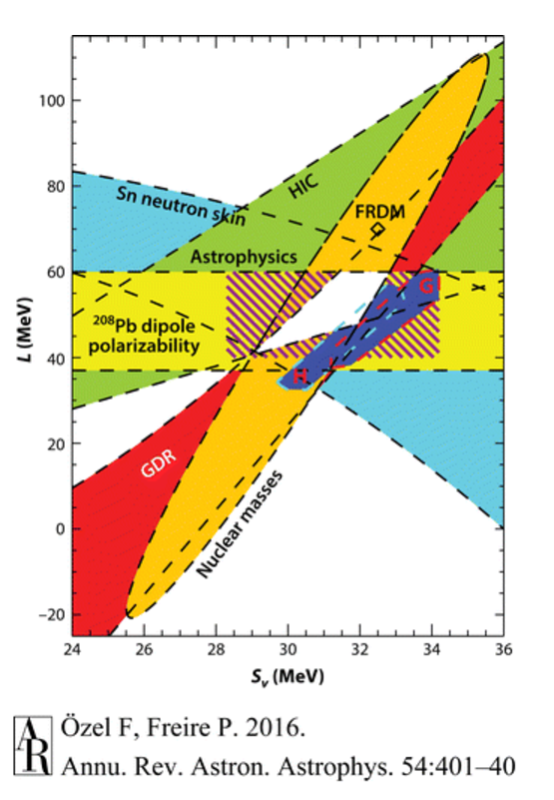
Disciplines intersecting over Equation of State. Ozel F, Freire P. 2016. Annu. Rev. Astron. Astrophys. 54:401-40
Notes:
This figure ha(s/d) a lot of explaining to do!

Slide 6
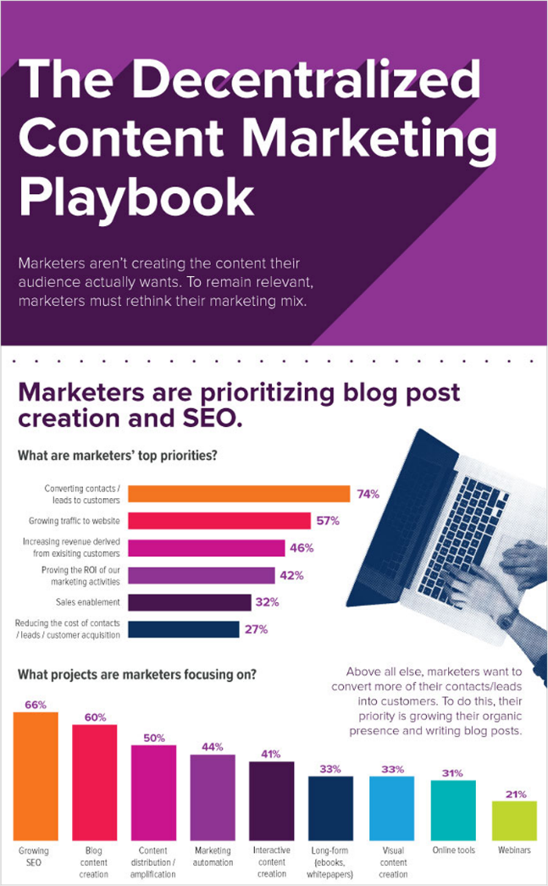
Infographics are the worst. https://blog.hubspot.com/marketing/decentralized-content-marketing-playbook

Slide 7
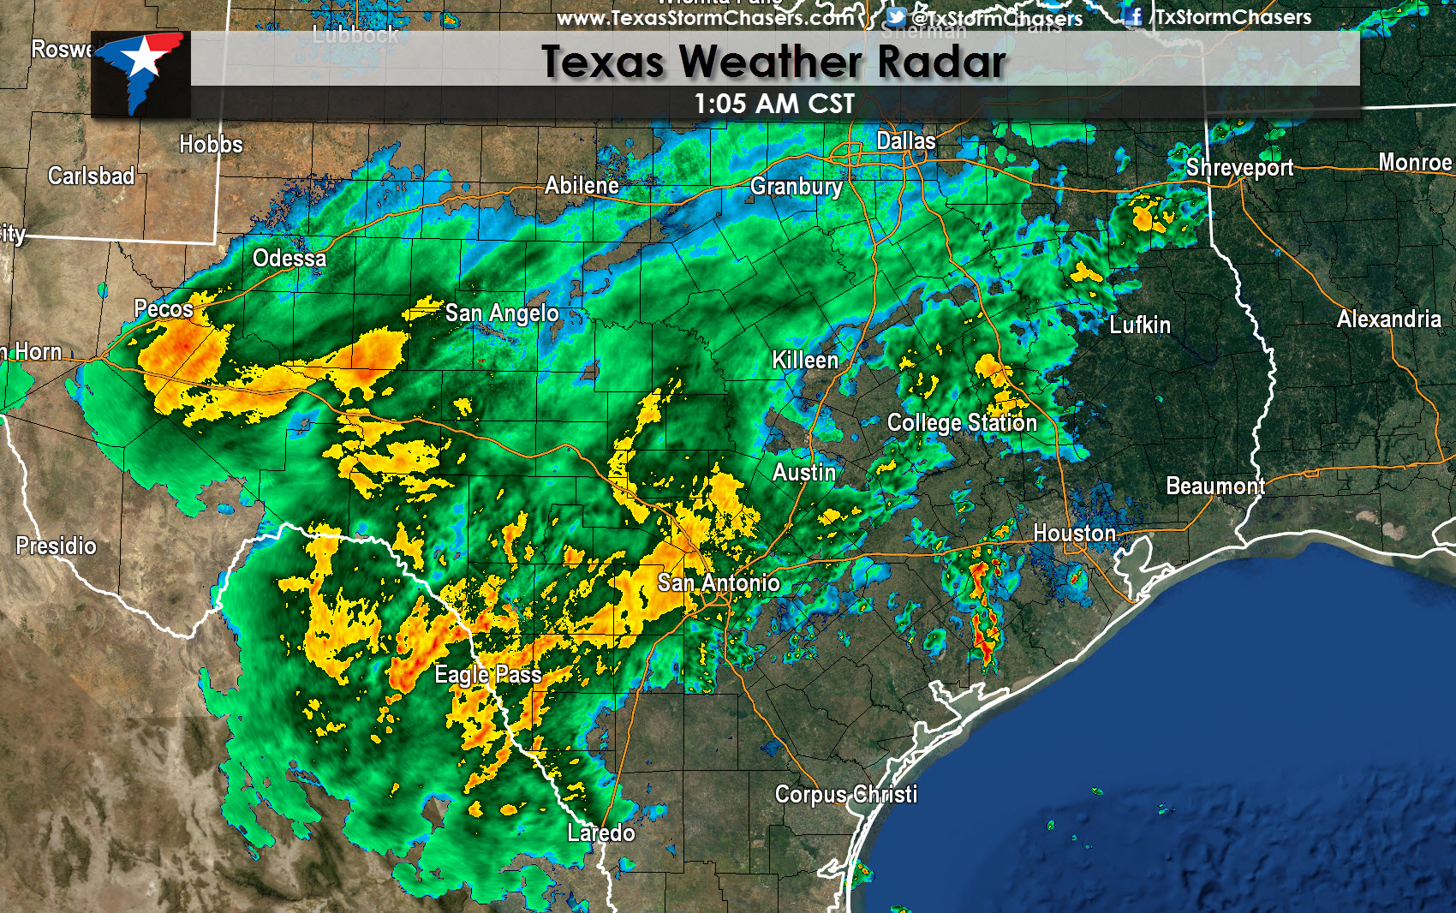
Texasstormchasers.com
Notes:
This colormap is terrible…
But if we used something else, the world would end
Conventions: Practices
Semantics: symbols or shapes that mean something to your domain

Slide 8
Purpose

Slide 9
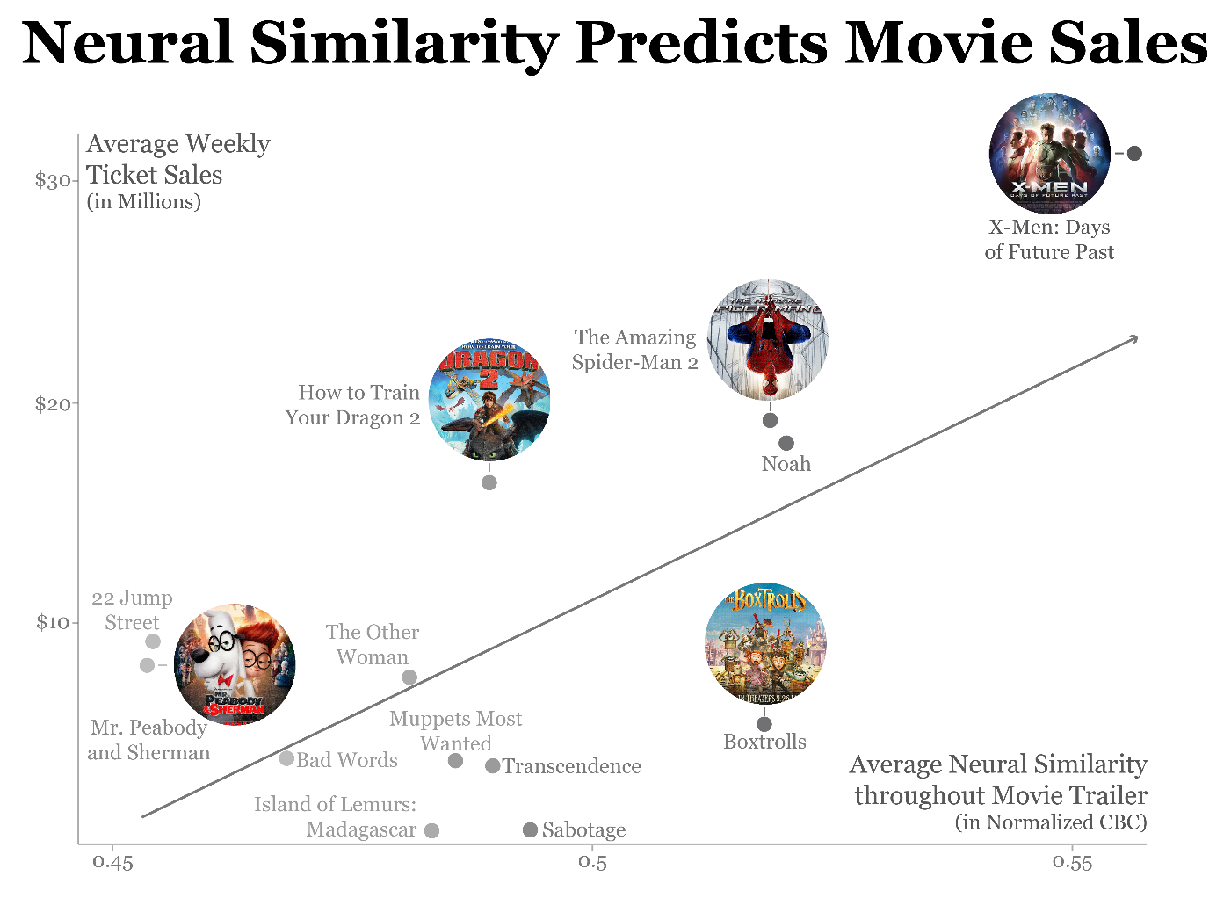
Brain response predicts movie sales. https://insight.kellogg.northwestern.edu/article/neuroscience-can-predict-movie-sales
Notes:
Explanation and presentation
Research vs Public is important here

Slide 10
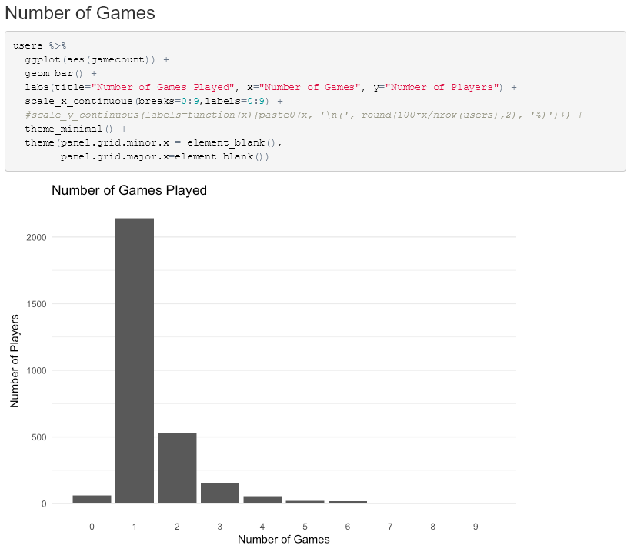
Internal analysis of games played. This slide is the source.
Notes:
Exploration
How good it looks isn’t very important

Slide 11
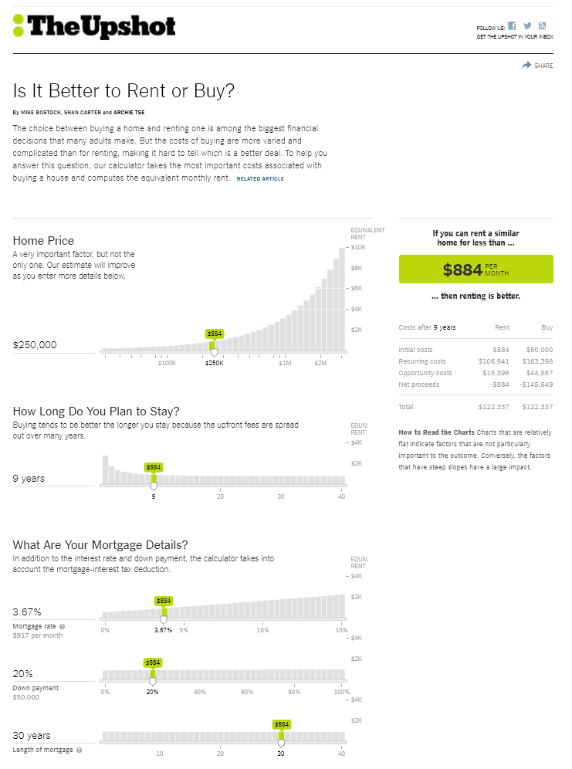
“Is it Better to Rent or Buy?” https://www.nytimes.com/interactive/2014/upshot/buy-rent-calculator.html
Notes:
Knowledge-production
The interaction and visual response actually creates knowledge for the user

Slide 12
Context

Slide 13
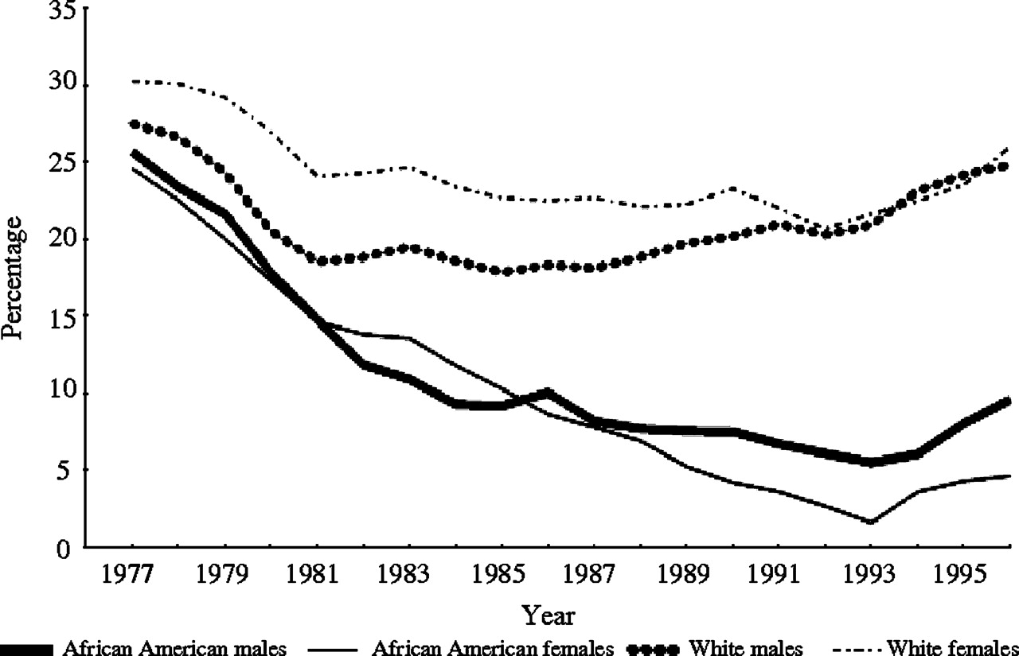
Lung Cancer Epidemiology. http://cebp.aacrjournals.org/content/18/12/3349
Notes:
Knowing the limits of where the viz will be:
Color,
Size,
etc

Slide 14
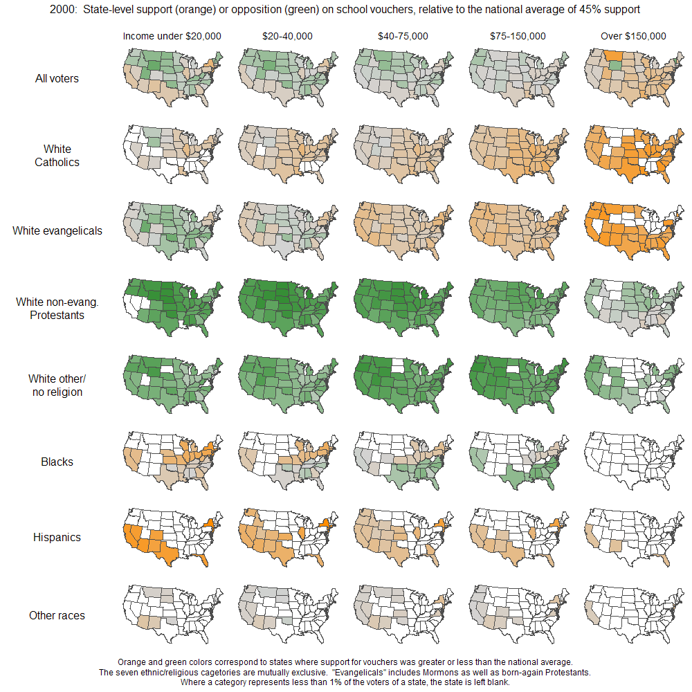
Public support for vouchers. http://andrewgelman.com/2009/07/15/hard_sell_for_b/
Notes:
Avoiding over-ambition
Small multiples
Sparklines

Slide 15
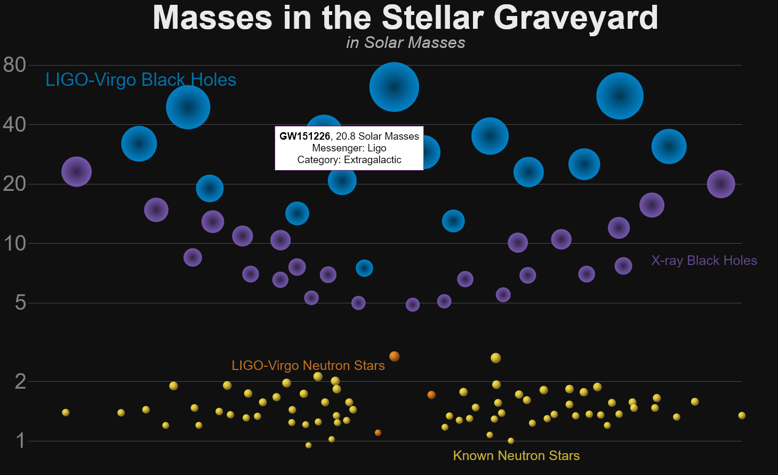
Masses of Dead Stars. https://media.ligo.northwestern.edu/gallery/mass-plot
Notes:
Show them the website?
Interaction
Entry Point
Priming

Slide 16
Notes:
Presenter:
What does this chart MEAN? What is the POINT? What is it COMMUNICATING?
What data can we get from this?
I’ll say this up front: this is a bad graph.
How do you look at this graph?
Where do you begin?
Where do your eyes move?
How do you compare these values?

Slide 17
Notes:
Presenter:
Say we separate these out. Which one of these sections is the largest?
Of the smallest pieces, which one is the smallest?
What are the specific percentages of each of these, if you could guess?
What would you do to improve this?

Slide 18
Notes:
Presenter:
This is a barchart rendering, straight out of Excel. The defaults are all shown here.
Critique this. What is wrong.
[Next]

Slide 19
Notes:
“The first thing that we can do to improve this chart is to rotate it. This allows the labels to be read more easily.”
But this still could be improved. Walk me through this. What would you do?
I’ll start at least by cheating a bit and sorting the data.
[Increase font sizes]
[Widen bars: remove empty space]
[Change bar color]
[Emphasize what is meaningful]
[Lighten line color]
[Shorten Axes]
[Axis: Display units to hundredths, Category to Percentage, 0 Decimal Places]
[Add Yellow to “Color Choice” bar]

Slide 20
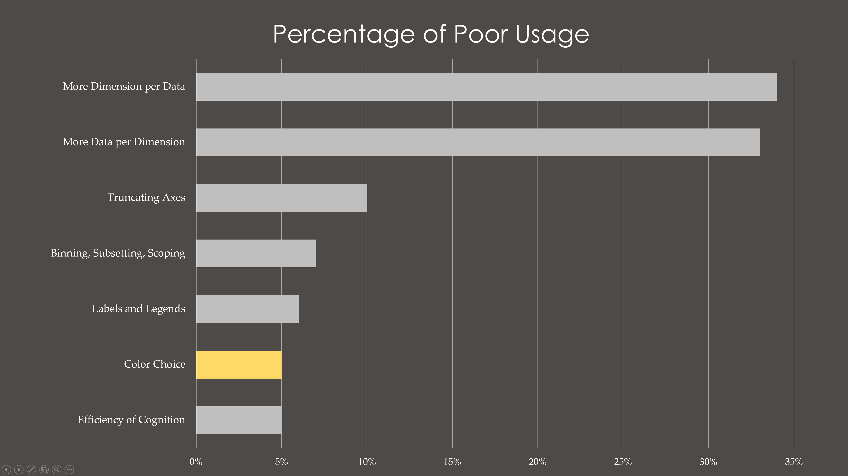
Notes:
“Let’s see how it turned out to my original edit…
Now, this chart is pretty good. I’d say that this is good enough for a scientific poster or paper.
But there are a few things you can do still (outside of excel now)
First, you’ll want to copy this image (screen shot or otherwise
Then you can edit it in Adobe InDesign or Photoshop”

Slide 21

Notes:
“The final result should look something like this.
Gridlines and values have been removed, now the data is directly on the chart itself. (NOTE VISUAL SKEPTICISM and remind about “knowing your audience”)
Why is this the best? Because your eyes hardly need to travel between gridline and bar, the exact value is now encoded onto its spatial representation. The order is meaningful.
One of the best things you can do is to remove legends, grids, or axes altogether. If you can communicate the exact same thing but without those extra pieces, you are doing an excellent job”

Slide 22

Notes:
A comparison from the start to its final form
A discussion for another time: why visualizing composition is not an easy task

Slide 23
Big Picture (review):
Audience: “Who is this for? What conventions/semantics should I follow or avoid?”
Purpose: “Am I exploring, explaining, or something else?”
Context: “How ambitious should my visual(s) be?”
Details (next):
Think Spatially: “What are the dimensions already in the data?”
Ensure Visual Quality: “Is this geometry telling the truth?”
Improve Data-to-Ink Ratio: “Is this [shape, color, layout] necessary?”

Slide 24
Think Spatially: What are the dimensions in the data?

Slide 25
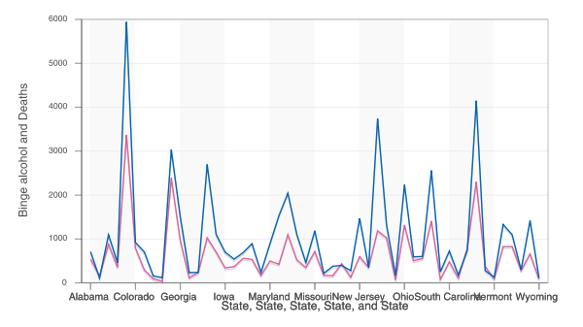
https://forums.somethingawful.com/showthread.php?threadid=3232647
Notes:
The most important thing to do when you begin visualizing data is to think spatially about it.
Sometimes you need to visualize your data in order to know what it even contains. This is basic exploratory analysis. Sometimes basic methods or functions can create monsters though.
If you aren’t thinking spatially about the meaning of your data, you can end up with a chart like this one.
Honestly, this chart is an abomination.
Does someone want to take a stab at this and figure out what is going on here?
A line graph communicates a rate, this is part of its semantic use. My immediate instinct is: oh, Binge alcohol and deaths as a pair of rate lines…
Uh oh, that doesn’t make sense here.
Each of these data points represents a different state, organized alphabetically. These are quantities organized by state.
Data points are missing on the horizontal axis, the horizontal axis has a horrible label, and the labels overlap each other.
But the real problem here is that it is a line graph. Lines communicate a connection between points. Lines imply a relationship of some kind. Lines can even imply a visual sense of movement.
But these states are independent of one another. There is no reason to connect California’s peak to Colorado’s low.
The shapes you use have semantics, which is to say there is a grammar to the graphics that is important to consider.
A group bar chart (with one bar for each) would communicate what this chart does in a way that is semantically effective.
But my instinct is that one more step of analysis would need to be done to the data: creating a ratio of Binge Alcohol to Deaths. This could be shown on a scatterplot with a regression line, to see if there is a relationship between those two variables.

Slide 26
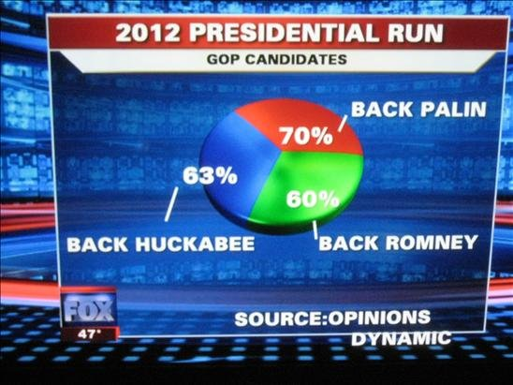
Originally from Fox News, cited at Media Matters
Notes:
Here’s a gem.
Someone want to take a stab at this one? What do you think is going on with this?
We are going to assume here that the data, not the graphic, is correct. If it is possible for a survey respondent to back multiple candidates then we need a different way to represent this data. Of course, there are misleading dimensions here too, since it is spatially very difficult to figure out which slice is actually the largest.

Slide 27
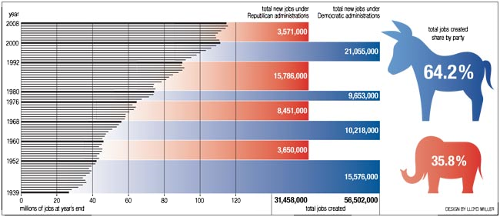
https://www.smashingmagazine.com/2010/05/imagine-a-pie-chart-stomping-on-an-infographic-forever/
Notes:
This chart adds multiple data to one dimension, which is quite complex.
Who wants to explain what is happening here? This one is rough, I don’t even understand it all the way.
But how do you read the second bars? Why is 3571000 the same length as 15786000? What does the axis label for total jobs created even mean?
Also, the donkey/elephant infographic is really confusing. How do you read that? Does the surface area correspond to the percentage? Just height?
Also, the graphical convention is to have time as the x axis (because it is independent) and for time to travel visually from left=lowest to right= highest: generally this is ideal. So the axis needs to be rotated and then flipped in order to visually fit this semantic convention.

Slide 28
Notes:
Our brain has to spatiall flip this twice to conform to normal left-right time conventions

Slide 29
Notes:
Going back to the original, we ask a very important question:
How do you “enter” the graphic?
We enter text from the top-left as a convention, but we have different reading patterns for graphs, charts, and visuals in general.
Part of thinking spatially is asking the question: how do you “enter” this graph? What is the starting point for the reader?
This graph does not have a good answer.

Slide 30
Ensure Visual Quality: Is this geometry telling the truth?

Slide 31
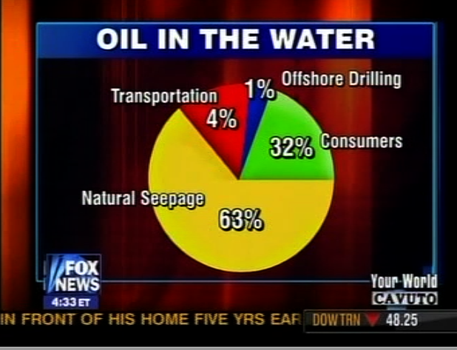
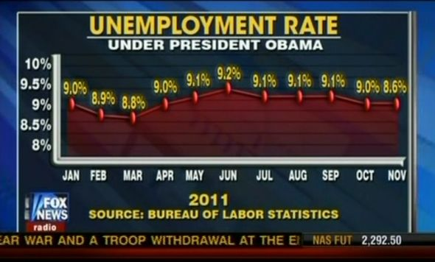
https://www.smashingmagazine.com/2010/05/imagine-a-pie-chart-stomping-on-an-infographic-forever/
Notes:
This next section is: “Ensure visual quality”
Sometimes the geometry is actually just wrong. These are two examples.
Critique these: what is wrong?
The first has a truncated axis (which is always tricky, if your audience isn’t quick on their feet). But most importantly? What is the lowest point in the chart?
On the right we see that the pie chart sizes are just incorrect entirely.

Slide 32
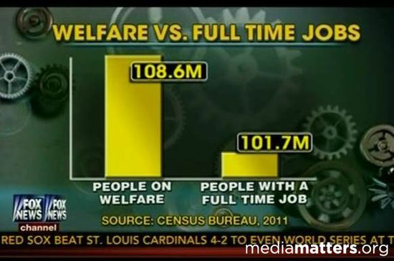
https://www.smashingmagazine.com/2010/05/imagine-a-pie-chart-stomping-on-an-infographic-forever/
Notes:
Other times, the geometry is misleading rather than simply wrong.
Anyone want to discuss why this chart is problematic?
Truncating an axis, like on the left, then also removing that axis is a huge no-no: the audience loses all reference to scale and then shapes become meaningless to the data they represent.

Slide 33
Improve Data-to-Ink Ratio: Does this [thing] contain real data?

Slide 34
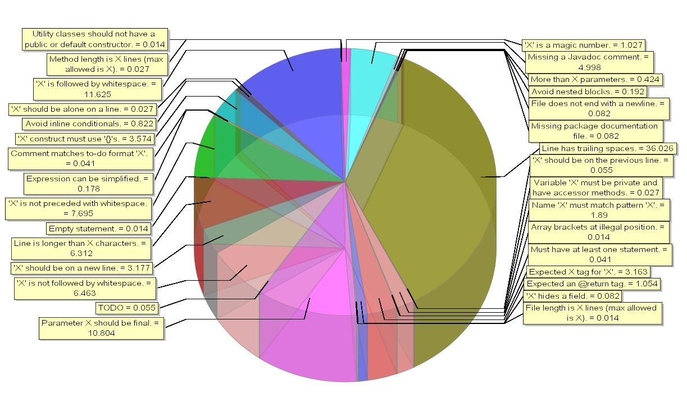
http://www.theusrus.de/blog/yet-another-pie-chart/
Notes:
Help me with this. This is a visualization of Java code and usage of certain parts of the code.
What is wrong with this?
We’ve talked about this already, but adding an extra dimension to data that does not have another dimension to display is the most common mistake. (the 3d part of this is not helpful, neither is the ability to see through it)
But what if dimensions were not just spatial, but also visual in general?
Every element of a visual should be considered, when thinking about its value to the data.
The color around the boxes, the lines that refer to each slice: these are all visual elements that do not add data.
Color is an important dimension in data: you can use it to redundantly encode a particular data or to emphasize something that would otherwise be easy to miss.
But the color use here is not only difficult for those with colorblindness, but it also only serves to show difference between datapoints. This is not leveraging the full power of color in our visual-spatial cognition.

Slide 35
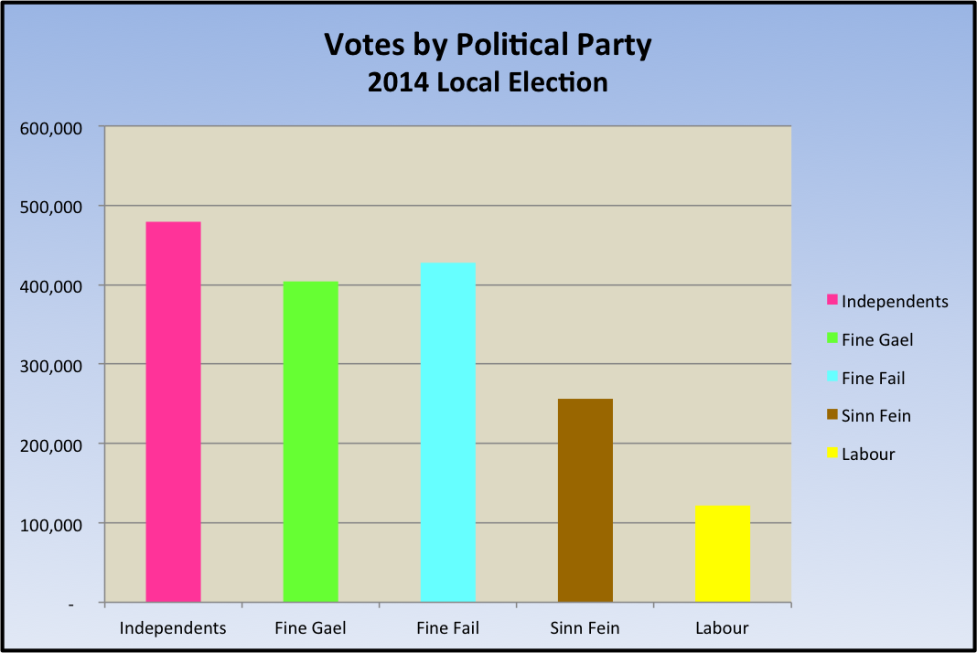
https://theanalyticsstore.ie/12-days-data-analytics-day-4-show-data-data/
Notes:
Here is an example, simplified, of why color use is often misunderstood.
This chart color codes different categories, but the spatial system here has already separated them. Redundant encoding on separation is not helpful.
There are two ways to visualize this better, depending on what your point is.
I will show you how to improve your data-to-ink ratio with this chart

Slide 36
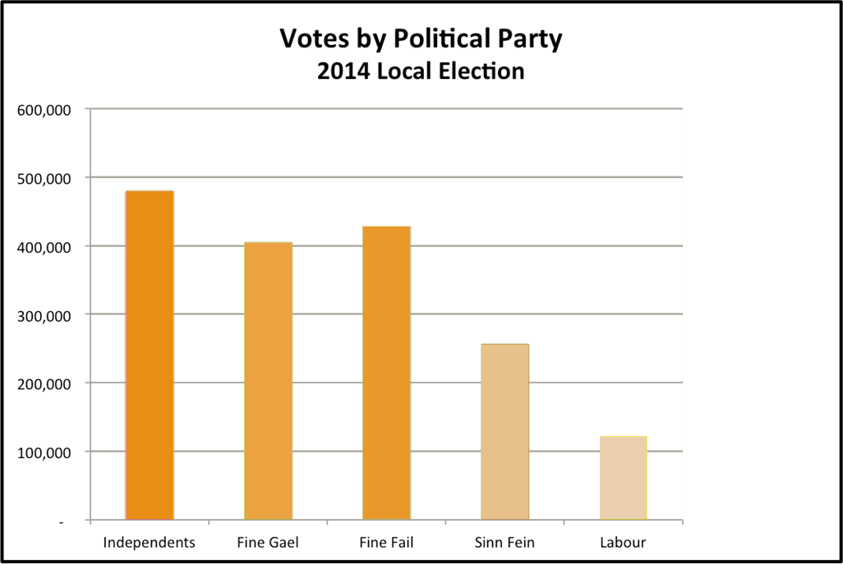
Notes:
The first kind of color use I want to talk about is scale.
Color encodes a dimension to data, and you can use it to show a dimension that is not spatially represented otherwise or to redundantly encode data that already exists.
There is a key difference between adding a dimension to data (like with a 3d pie chart) and redundant encoding:
Redundant encoding leverages a different part of your visual system to fast-track your understanding of the same dimension.
Using length and width to describe one dimension is not helpful because it actually adds visual complexity to the same visual systems in our understanding
But using length and color together? That is redundant encoding and it is sometimes helpful.
This is just an example case, and it is not particularly useful because there are not very many data points.
As a note, the background color is useless fluff so I removed it as well.

Slide 37
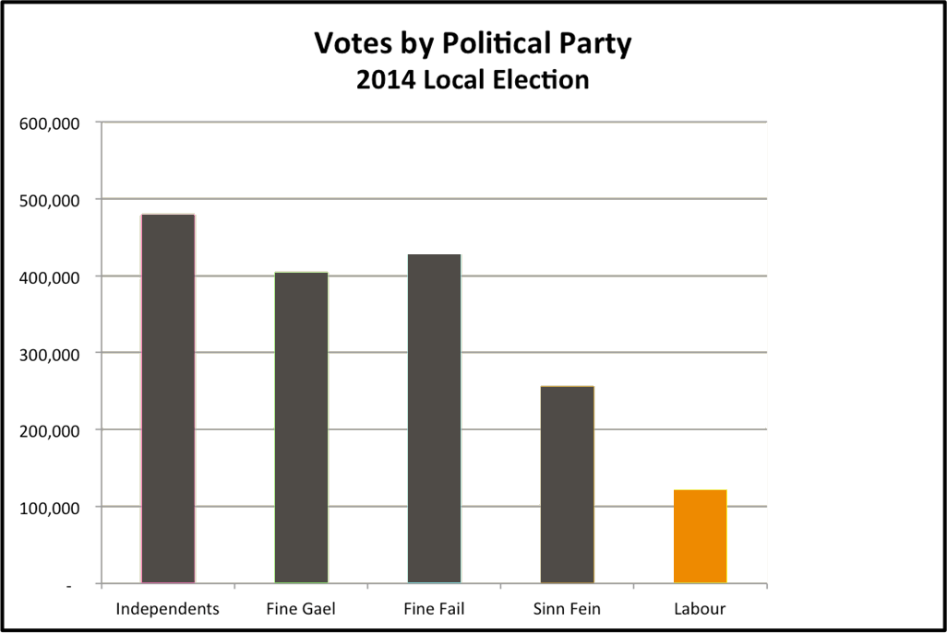
Notes:
But emphasis is the best kind of color use for this chart: you point the audience to something important visually by creating contrast: all the colors are the same except one thing.
As a note, if you don’t need emphasis you shouldn’t use it. So if nothing is particularly important to emphasize in a chart: don’t do it.
And of course, as a note: if you are producing a chart for a poster or a publication, it’s not a bad idea to drop the chart into photoshop or illustrator to make some fine tuned edits of the visual elements (such as color, background choice, etc), especially if you are struggling with some part of your code.
As a note:
This chart would look much better if it wasn’t a white background on a black background. A nice looking research poster doesn’t look like this (which appears to frame the entire figure in a stark contrast)
But rather, even considering the context of your chart is important at times.

Slide 38
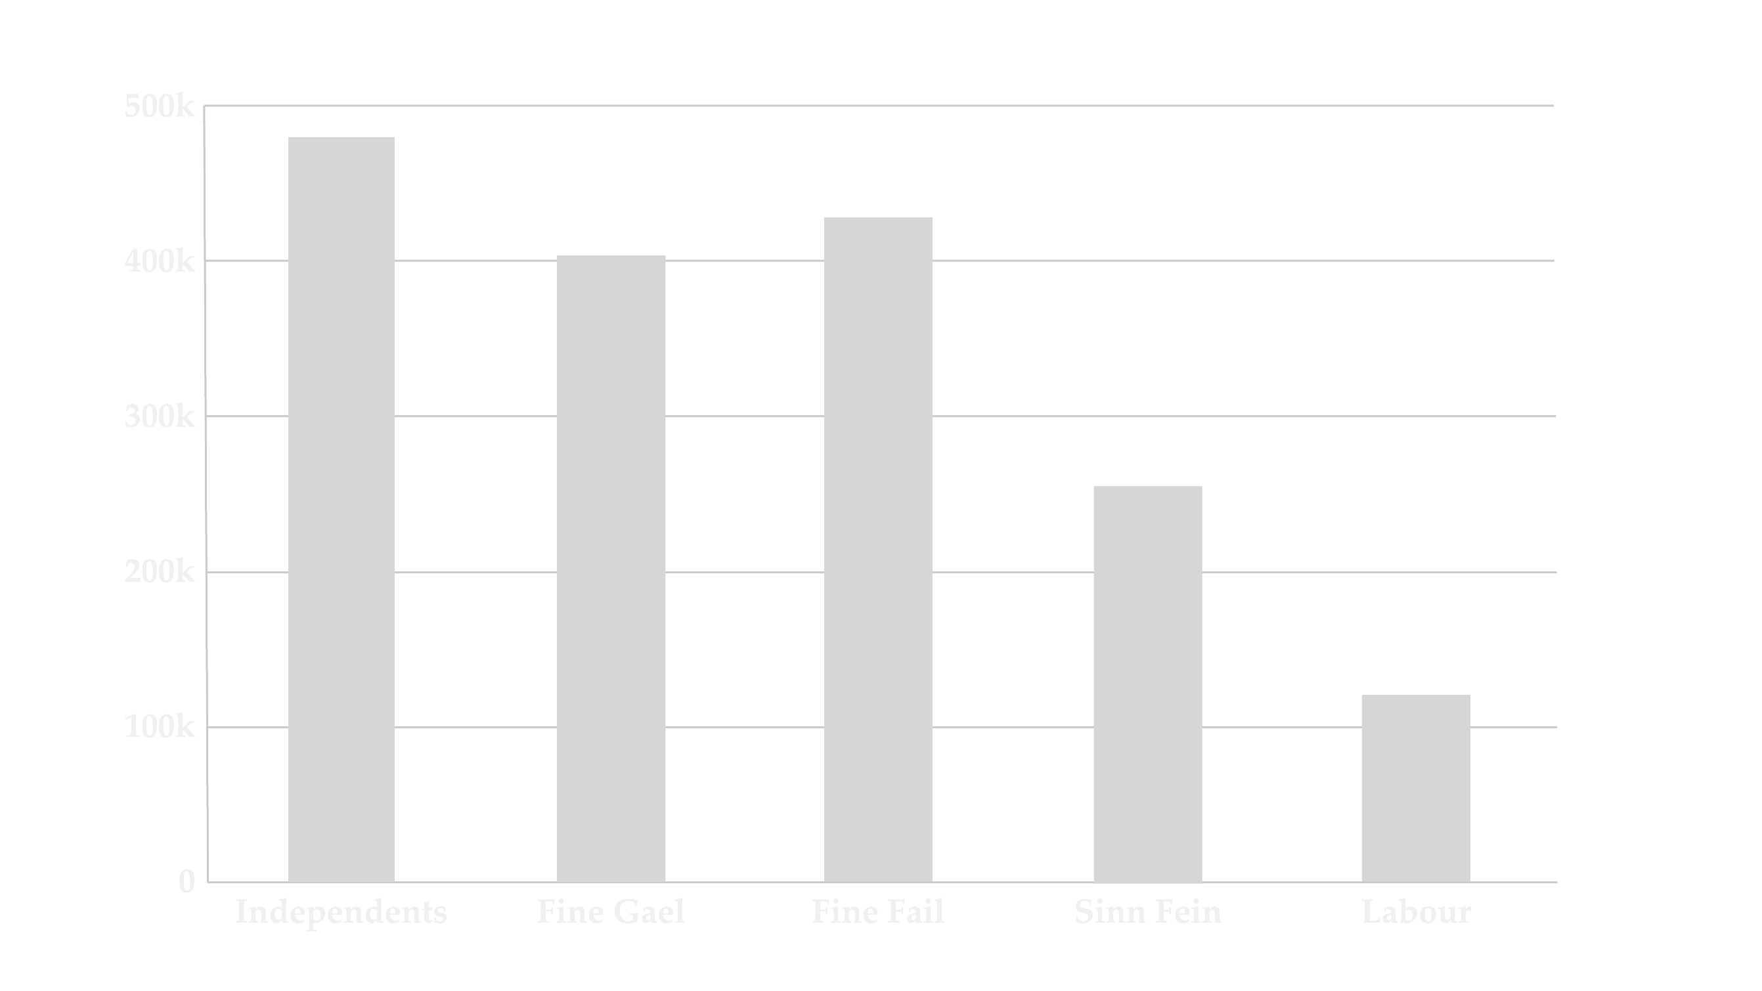
Votes By Political Party 2014 Local Election
Notes:
This form has a few nice touches and is certainly publication-quality:
It abbreviates the y axis values and has a transparent background
The foreground color is intentionally made to contrast nicely with the background color choice

Slide 39
Votes By Political Party 2014 Local Election
Notes:
This chart would look pretty awful on white paper, but looks great in the previous environment

Slide 40
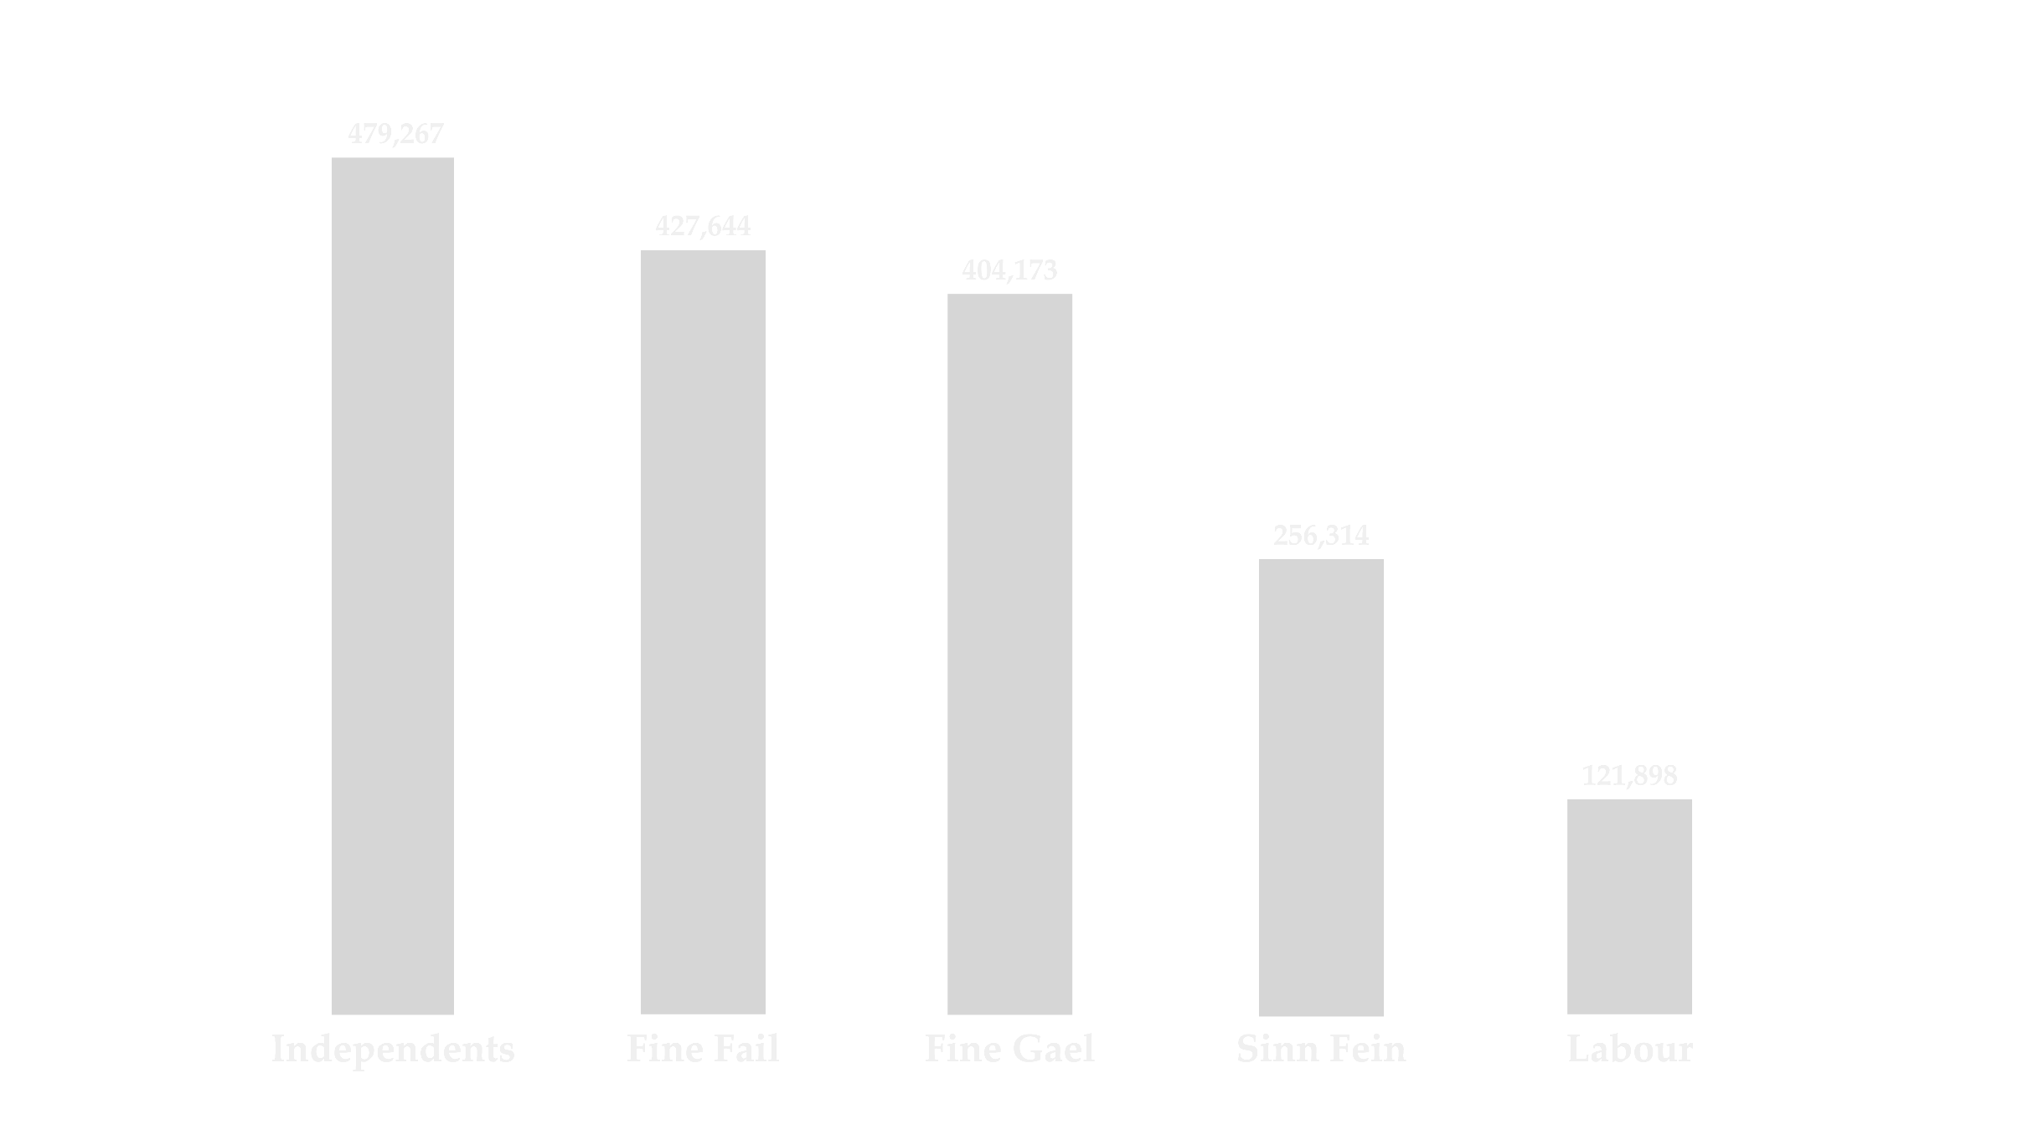
Votes By Political Party 2014 Local Election
Notes:
As mentioned before, you can do just a few things to upgrade your data-to-ink ratio at this point:
Remove the axes altogether if they are not needed and then encode the data directly onto the visual
Also, it’s polite to sort the data for your reader unless the order is somehow meaningful (which it was not, in this case)

Slide 41
Notes:
Enough about the theory.
Here is a pair of scatterplots.
We want to compare the voting patterns of congresscritters back in congress 90 and then the most recent congress we have data for (congress 114).
The visuals you see are defaults from excel.
If our goal is to compare these two graphs, what can we do to improve them?
[Let audience interact, try to implement their changes as they give feedback]

Slide 42
Notes:
Here’s the final form that I came up with:
Increase transparency of gridlines
Move axes out of chart
Ensure that the scales are the same on either chart
Reduce the number of gridline ticks

Slide 43
Data Sources:
41: DW-NOMINATE Data:
ftp://k7moa.com/junkord/HANDSL01114A20_STAND_ALONE_30.DAT
Reference Sources:
Bertin, Jacques. The Grammar of Graphics
Drucker, Johanna. Graphesis
Franconeri, Steve. [General Research]
Kirk, Andy. Data Visualization
Kosara, Robert. Eagereyes.org
Lupton, Ellen. Graphic Design: the New Basics
Munzner, Tamara. Visualization Analysis and Design
Pater, Ruben. The Politics of Design
Sherin, Aaris. Design Elements: Color Fundamentals
Tufte, Edward. Beautiful Evidence
Visual Display of Quantitative Information
Visual Explanations
Thank you
Frank Elavsky, Data Visualization Specialist
Research Computing, Northwestern University

